Slide 1
Perfect Forward Secrecy
Andy Brodie – Principal Design Engineer
MeetUp: Worldpay - Developers, Testers and Engineers - 30 September 2015
Notes:
Welcome!
I’m Andy Brodie, Principal Design Engineer at Worldpay.

Slide 2
Perfect Forward Secrecy
Andy Brodie – Principal Design Engineer
MeetUp: Worldpay - Developers, Testers and Engineers - 30 September 2015
Notes:
Some cryptographers, such as Daniel Bernstein, have suggested that “perfect” incorrectly suggests that there are no possible flaws with PFS, so instead have recommended dropping “perfect” or renaming completed to “key erasure”.

Slide 3
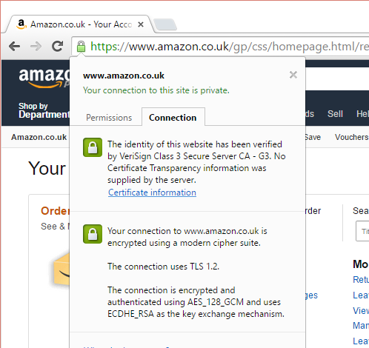
What are we talking about?
Notes:
TLS is Ubiquitous on the web
SSL became TLS in Jan 1999 with TLS 1.0 (SSL 3.1).
TLS 1.2 is current – Aug 2008
TLS 1.3 is draft –Expires March 2016

Slide 4
Forward Secrecy Theory
Notes:
Mathematic knowledge isn’t necessary to understand how security works, as long as you’re prepared to accept assertions like “this is incredibly hard to work out, so trust it”, and so on.

Slide 5
Introducing Alice and Bob
Alice’s Client
Bob’s Server
Hello Bob
Notes:
Alice and Bob originate from a 1977 paper by Ron Rivest about RSA. Alice is Party A and Bob is Party B.

Slide 6
Introducing Alice and Bob… and Eve
Eve
Alice’s Client
Bob’s Server
Hello Bob
Notes:
Eve is an eaves-dropper, she wants to read what Alice and Bob are talking about.

Slide 7
Using Encryption to lock Eve out of the conversation
Eve
Alice’s Client
Bob’s Server
v4na97dmx
Hello Bob
v4na97dmx
v4na97dmx
Hello Bob
Notes:
Alice and Bob use encryption so that Eve can’t read the plaintext. Instead Alice and Bob either use the same key (symmetric key encryption) or different keys (asymmetric key encryption) to provide privacy, and lock Eve out.

Slide 8
Eve doesn’t have the key … yet!
wmojlofijlvofijmwelo48utw8rwrnr4aacrynawrynciwurncikr
tvo4eithesilutvhnky4wiuevjrhfj5ire
twt4wynvw9sytrwaryws87yrjlw8tyl9ytwlyr4wejdrtrwrte5y
atvw4tluiwh4kitaucenrowy4ircwynaiufhsadasd
Wauthaiufshneug5uury4i7y.awey5iu4v
lruitylsieutvl4ot5y4lovutlinrfsdtvoimcoshnoilsjgh
njkylbuyjbkghmsefx3uri4u5y
Notes:
However, the conversations between Alice and Bob can be recorded by Eve, who hopes that one day the secret key will be available to her.

Slide 9
Eve wants the key…
wmojlofijlvofijmwelo48utw8rwrnr4aacrynawrynciwurncikr
tvo4eithesilutvhnky4wiuevjrhfj5ire
twt4wynvw9sytrwaryws87yrjlw8tyl9ytwlyr4wejdrtrwrte5y
?
atvw4tluiwh4kitaucenrowy4ircwynaiufhsadasd
Wauthaiufshneug5uury4i7y.awey5iu4v
lruitylsieutvl4ot5y4lovutlinrfsdtvoimcoshnoilsjgh
njkylbuyjbkghmsefx3uri4u5y
Notes:
Now Eve has all the conversations between Alice and Bob, she can turn her attention to discovered the key that will unlock all the conversations.

Slide 10
Eve’s Attacks – Brute Force
Eve
v4na97dmx
?
v4na97dmx
key₁
4vnfd38eu
v4na97dmx
key₂
65tvfhyts
v4na97dmx
key₃
j78mfdawe
v4na97dmx
key₄
lotfdwt54
Up to 340,282,366,920,938,463,463,374,607,431,768,211,456 (2¹²⁸) keys later….
v4na97dmx
key_{n}
Hello Bob
Notes:
AES-128 shown in example. http://bugcharmer.blogspot.co.uk/2012/06/how-big-is-2128.html.
This is really difficult.

Slide 11

Eve’s Attacks – Cracking the encryption algorithms and protocols
Eve
v4na97dmx
Hello Bob
Notes:
Eve is now taking on a large number of professional and academic cryptographers, as well as most major governments.
This is also really difficult.
Image by Tom Brown, licensed under Creative Commons Attribution 2.0 Generic (CC by 2.0)
See https://creativecommons.org/licenses/by/2.0/ for full license.
Original: https://flic.kr/p/edPJVt

Slide 12





Eve’s Attacks – Human Weaknesses & Social Engineering
Eve
v4na97dmx
v4na97dmx
v4na97dmx
v4na97dmx
Hello Bob
Hello Bob
Hello Bob
Hello Bob
Notes:
Given the difficult of the first two attacks, Eve will probably take a more social approach to the problem.

Slide 13
Golden Rule: Never say “If we get hacked”, it’s “When we get hacked”.
Eve

Slide 14
What if Eve gets the key?
wmojlofijlvofijmwelo48utw8rwrnr4aacrynawrynciwurncikr
tvo4eithesilutvhnky4wiuevjrhfj5ire
twt4wynvw9sytrwaryws87yrjlw8tyl9ytwlyr4wejdrtrwrte5y
atvw4tluiwh4kitaucenrowy4ircwynaiufhsadasd
Wauthaiufshneug5uury4i7y.awey5iu4v
lruitylsieutvl4ot5y4lovutlinrfsdtvoimcoshnoilsjgh
njkylbuyjbkghmsefx3uri4u5y
Notes:
The conversations between Alice and Bob can be recorded by Eve, who hopes that one day the secret key will be available to her.

Slide 15
When Eve manages to obtain the key
My postal address is 270 Milton Road, Cambridge
Bob, my CVV number is 452
My credit card is an American Express
Bob, my CVV number is 452
Alice, I’ve refunded £100.00 to your card.
Alice, your order of the latest OilyBoy magazine is on it’s way.
Hey Bob, here’s my Ashley Madison account handle….
Notes:
OilyBoy is a Japanese magazine aimed at older children. For some reason, most people think it’s a magazine about something else. http://www.thesartorialist.com/photos/i-kid-you-not-some-of-the-best-mens-magazines-in-japan/ (surprisingly SFW)

Slide 16
When Eve manages to obtain the key with Forward Secrecy enabled.
wmojlofijlvofijmwelo48utw8rwrnr4aacrynawrynciwurncikr
tvo4eithesilutvhnky4wiuevjrhfj5ire
My credit card is an American Express
atvw4tluiwh4kitaucenrowy4ircwynaiufhsadasd
Wauthaiufshneug5uury4i7y.awey5iu4v
lruitylsieutvl4ot5y4lovutlinrfsdtvoimcoshnoilsjgh
njkylbuyjbkghmsefx3uri4u5y
Notes:
OilyBoy is a Japanese magazine aimed at older children. For some reason, most people think it’s a magazine about something else. http://www.thesartorialist.com/photos/i-kid-you-not-some-of-the-best-mens-magazines-in-japan/ (surprisingly SFW)
10 minutes in at this point.

Slide 17
TLS and Forward Secrecy
Notes:
So, that’s the theory of Forward Secrecy and what it provides. Now let’s look at how Forward Secrecy is achieved in TLS.

Slide 18
TLS (RFC5246) provides:
Authentication
Alice trusts it’s really Bob.
Privacy
Conversation is encrypted.
Integrity
Alice & Bob can tell if messages are tampered with.
https://tools.ietf.org/html/rfc5246

Slide 19
TLS provides 37 Cipher Suites
TLS_ECDHE_ECDSA_WITH_AES_128_CBC_SHA256
Protocol
Authentication
Bulk Encryption
Message Authentication
/ Pseudo Random Function
Key Exchange
Look out for:
Combined Key Exchange and Authentication.
NULL, ANON or EXPORT in the cipher name.
Notes:
Each cipher is assigned a unique unsigned 16 bit number.
Full list specified here: http://www.iana.org/assignments/tls-parameters/tls-parameters.txt
NULL, EXPORT or ANON
EXPORT means the strength of the algorithm is limited for (now defunct) export from US territories.
NULL/ANON means that that particular feature is not used.

Slide 20
TLS provides 37 Cipher Suites
TLS_RSA_WITH_AES_128_CBC_SHA256
Protocol
Bulk Encryption
Authentication & Key Exchange
Message Authentication
/ Pseudo Random Function
Look out for:
Combined Key Exchange and Authentication.
NULL, ANON or EXPORT in the cipher name.
Notes:
Each cipher is assigned a unique unsigned 16 bit number.
Full list specified here: http://www.iana.org/assignments/tls-parameters/tls-parameters.txt

Slide 21
TLS Features: Data Exchange Bulk Encryption
Privacy between Alice and Bob.
Uses a symmetric key for performance.
Generated on the fly by Alice & Bob.
Changes regularly.
Never stored, so very difficult to obtain.
These are not the keys Eve will attack.
Although, if compromised will give Eve what she wants.
Huge amount of effort spent in ensuring this remains secret.
Notes:
How often?

Slide 22
TLS Features: Key Exchange
Client MAC Key
Server MAC Key
Client Write Key
Pre-master Secret
Master Secret
Key Material
Server Write Key
Client Write IV
Server Write IV
Notes:
Premaster secret: minimum 46 bytes. Size varies on key exchange mechanism (RSA=48 bytes)
Master Secret: Always 48 bytes
Key Material: Depends bulk encryption and HMAC strengths, biggest is 128 bytes for AES_256_CBC_SHA256 (2 x 32 byte keys for each)
Key Material (key_block) is generated using the PRF applied to the key master secret.
The Client Write and Server Write symmetric keys are created, ultimately, from a Pre-master Secret.

Slide 23
Key Exchange without Forward Secrecy
Alice’s Client
Bob’s Server
Pre-master Secret
Pre-master Secret
Eve
Bob’s Public Key
Bob’s Private Key
aw49v8rnawih
aw49v8rnawih
Notes:
Without Forward Secrecy Alice creates the pre-master secret, encrypts it with Bob’s Public Key (only Bob can decrypt this).

Slide 24
Bob’s private key is Eve’s target
Alice’s Client
Bob’s Server
Pre-master Secret
Pre-master Secret
Eve
Bob’s Public Key
Bob’s Private Key
aw49v8rnawih
aw49v8rnawih
Notes:
Bob’s private key is what Eve wants. With that she can decrypt the pre-master secret and thus generate the symmetric keys to decrypt all the conversations.

Slide 25
Key Exchange with Forward Secrecy
Alice’s Client
Bob’s Server
Ephemeral Public Key
Pre-master Secret
Pre-master Secret
Eve
Ephemeral Public Key
Ephemeral Private Key
ry5ebyseyet4
ry5ebyseyet4
Notes:
With Forward Secrecy Bob sends Alice a public key (or enough information to create a public key) Alice creates the pre-master secret, encrypts it with Bob’s Public Key (only Bob can decrypt this).

Slide 26
Why Forward Secrecy is important
Suites without Forward Secrecy:
Suites with Forward Secrecy:
Use the public key in Bob’s certificate and corresponding private key encrypt secrets that create the symmetric key.
Create a new public / private key pair to encrypt secrets that create the symmetric key.
Which means that…
Which means that…
Obtain Bob’s private key and all conversations can be decrypted.
Bob’s private key irrelevant to decryption.
If the ephemeral key is obtained then only one conversation can be decrypted.

Slide 27
FS Compatible Cipher Suites use Ephemeral Keys
Key Exchanges that support Forward Secrecy:
DHE - Diffie-Hellman Ephemeral
ECDHE - Elliptic Curve Diffie-Hellman Ephemeral
DH_anon - Anonymous Diffie-Hellman
Example:
TLS_ECDH_ECDSA_WITH_AES_128_GCM_SHA256
TLS_ECDHE_ECDSA_WITH_AES_128_GCM_SHA256
Notes:
DH_anon suites are also ephemeral, but as the “anon” part means that there’s no authentication of the server or client, this is typically never used. This is because there’s little point in Alice having a secure conversation with someone who could masquerading as Bob.

Slide 28
Forward Secrecy in Java
Using TLS in your Java apps.

Slide 29
Java Secure Sockets Extensions (JSSE)
Java Cryptography Architecture (JCA) is the “provider” architecture for security-related algorithms.
Java Secure Socket Extension is a layer over the JCA to provide an SSL and TLS implementation.
Notes:
Java Secure Sockets extensions build on the Java Cryptography Architecture (JCA) to provide an implementation of SSL and TLS. Unfortunately the classes were named before TLS came about, so most classes have an “SSL” prefix.

Slide 30
TLS in JSSE – Server Step 1 – High Level Process
public void go() throws Exception {
// Create a SSLServerSocketFactory with configured Key Store
SSLServerSocketFactory socketFac = createSSLServerSocketFactory();
// Create a server socket to use
SSLServerSocket serverSocket = (SSLServerSocket)
socketFac.createServerSocket(0, 0);
// Configure the server socket with a cipher suite (optional)
serverSocket.setEnabledCipherSuites(new String[] {
"TLS_ECDHE_RSA_WITH_AES_128_GCM_SHA256" });
// Wait for a connection from a client
serverSocket.accept();
}
Notes:
Logging output, server in purple, client in red, common in white.

Slide 31
TLS in JSSE – Server Step 2 – Configuring the Socket Factory
public SSLServerSocketFactory createSSLServerSocketFactory()
throws Exception {
// Create an SSLContext configured for TLS only
SSLContext serverContext = SSLContext.getInstance("TLS");
// Initialise with a set of private keys (and corresponding certs)
serverContext.init(loadServerKeys(), null, null);
// Create the server socket factory
return serverContext.getServerSocketFactory();
}
Notes:
Logging output, server in purple, client in red, common in white.

Slide 32
TLS in JSSE – Server Step 3 – Loading Keys for SSLContext
public KeyManager[] loadServerKeys() throws Exception {
// Create a key store in memory
String defaultKeyStoreType = KeyStore.getDefaultType();
KeyStore ksKeys = KeyStore.getInstance(defaultKeyStoreType);
// Populate from the prepared keystore on disk
InputStream storeInput = new
FileInputStream("ServerPrivateKeyStore.jks");
ksKeys.load(storeInput, "storepass".toCharArray());
// Set up a default Key Manager Factory (works with PKCS)
String kmfAlg = KeyManagerFactory.getDefaultAlgorithm();
KeyManagerFactory kmf = KeyManagerFactory.getInstance(kmfAlg);
// Provide a password to the keys we want
kmf.init(ksKeys, "keypass".toCharArray());
return kmf.getKeyManagers();
}
Notes:
Logging output, server in purple, client in red, common in white.

Slide 33
TLS in JSSE – Client Step 1 – High Level Process
public void go() throws Exception {
// Create a SSLServerSocketFactory with certificates to trust
SSLSocketFactory socketFac = createSSLSocketFactory();
// Create a socket, but don't connect yet as we…
SSLSocket socket = (SSLSocket) socketFac.createSocket();
// Configure the socket with a cipher suite (optional)
socket.setEnabledCipherSuites(new String[] {
"TLS_ECDHE_RSA_WITH_AES_128_GCM_SHA256" });
// Connect to a listening server
socket.connect(new InetSocketAddress("hostname", 10000));
}
Notes:
Logging output, server in purple, client in red, common in white.

Slide 34
TLS in JSSE – Client Step 2 – Configuring the Socket Factory
public SSLSocketFactory createSSLSocketFactory() throws Exception {
// Create an SSLContext configured for TLS v1.2 only
SSLContext clientContext = SSLContext.getInstance("TLSv1.2");
// Initialise with a set of certificates that we will trust
clientContext.init(null, loadServerCertificates(), null);
return clientContext.getSocketFactory();
}
Notes:
Logging output, server in purple, client in red, common in white.

Slide 35
TLS in JSSE – Client Step 3 – Loading Certificates for SSLContext
public TrustManager[] loadServerCertificates() throws Exception {
// Create an empty key store in memory
InputStream trustStoreIS =
new FileInputStream("ServerPublicCertificateKeystore.jks");
KeyStore trustStore = KeyStore.getInstance(KeyStore.getDefaultType());
// Populate from the prepared certificate store on disk
trustStore.load(trustStoreIS, "storepass".toCharArray());
// Create trust manager that is used to check server certificates
String defaultTrustManagerAlgorithm =
TrustManagerFactory.getDefaultAlgorithm();
TrustManagerFactory tmf =
TrustManagerFactory.getInstance(defaultTrustManagerAlgorithm);
tmf.init(trustStore);
return tmf.getTrustManagers();
}
Notes:
Logging output, server in purple, client in red, common in white.

Slide 36
And because it’s Java…
Exception
KeyStoreException
NoSuchAlgorithmException
CertificateException
IOException
UnrecoverableKeyException
KeyManagementException

Slide 37
Simple Client/Server Application
Client
Server
Fri Aug 28 13:25:31 BST 2015
Notes:
Client and Server use plain socket APIs to send the current date and time.

Slide 38
Output from CombinedServerAndClient – no TLS
0 [main] INFO - Running demo with plain sockets
13 [Server] INFO - TimeServer is ready to accept connections
15 [Server] INFO - Waiting for connection on port 29047
15 [Client] INFO - Creating socket to localhost:29047
18 [Client] INFO – Using plain sockets
30 [Client] INFO - Reading data from server
30 [Server] INFO - Accepted client, writing data
48 [Server] INFO - Sent "Tue Sep 22 15:53:51 BST 2015"
48 [Server] INFO – Closing socket
48 [Client] INFO - Received: "Tue Sep 22 15:53:51 BST 2015"
49 [Client] INFO – Closing socket
49 [main] INFO - Completed demo with plain sockets
Notes:
Logging output, server in purple, client in red, common in white.

Slide 39
Output from CombinedServerAndClient – TLS
0 [main] INFO - Running demo with TLS
384 [Server] INFO - TimeServer is ready to accept connections
526 [Server] INFO - Waiting for connection on port 40886
528 [Client] INFO - Creating socket to localhost:40886
679 [Client] INFO – Using TLS_ECDHE_ECDSA_WITH_AES_128_CBC_SHA256
538 [Client] INFO - Reading data from server
538 [Server] INFO - Accepted client, writing data
605 [Server] INFO - Sent "Wed Sep 23 09:08:28 BST 2015"
605 [Server] INFO - Closing socket
605 [Client] INFO - Received: "Wed Sep 23 09:08:28 BST 2015“
605 [Client] INFO - Closing socket
605 [main] INFO - Completed demo with TLS

Slide 40
Debugging TLS
Enable JSSE Debug using JVM property:
-Djavax.net.debug=all to debug everything
-Djavax.net.debug=help to show all options

Slide 41
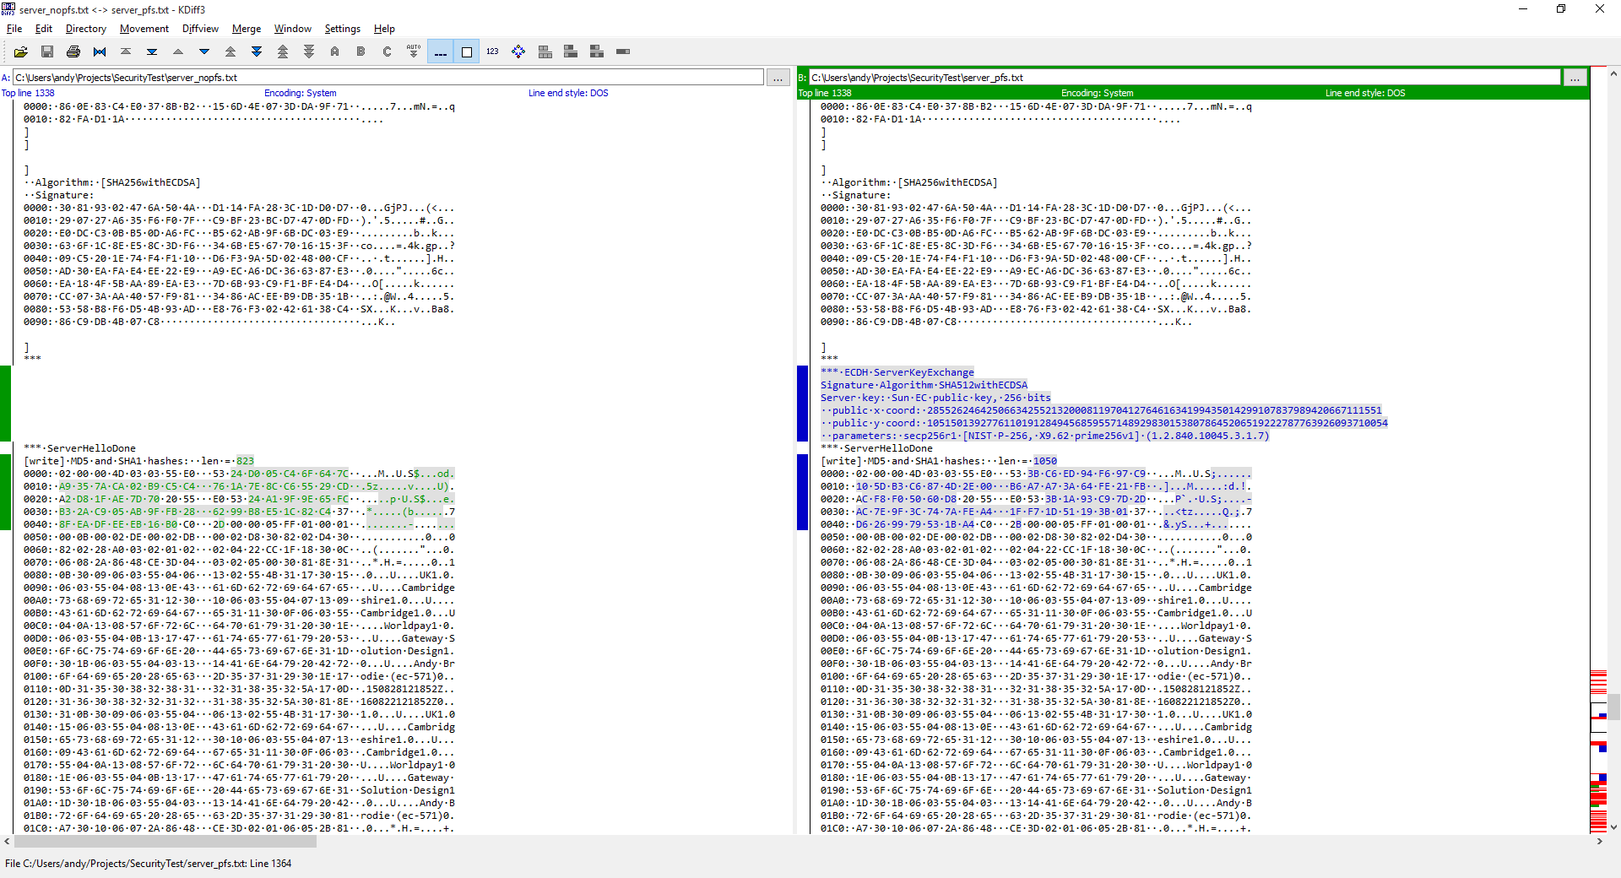
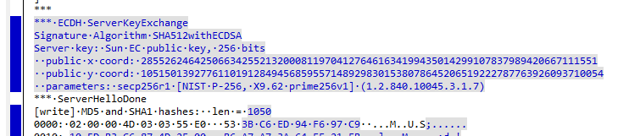
Seeing ephemeral key generation in action from Java debugging

Slide 42
To show that the ephemeral key is not re-used

Slide 43
Making things even more secure
Install unrestricted policy files.
Enable large DH ephemeral keys:
-Djdk.tls.ephemeralDHKeySize=2048
Disable all weak ciphers:
Any suites with ANON, NULL or EXPORT.
Use Apache and OpenSSL.
Java often lags behind.
Notes:
Unrestricted policy files: http://www.oracle.com/technetwork/java/javase/downloads/jce8-download-2133166.html

Slide 44
Where’s the code?
All code, docs and this presentation.
Published on GitHub.
MIT Licensed.
https://github.com/andybrodie/fsdemoapp.git
Built and Run using:
Java 8 build 1.8.0_60-b27.
Maven 3.3.3.
Eclipse Mars.
SLF4J

Slide 45
Bibliography
Alfred J. Menezes, P. C. (2011, July 8). Handbook of Applied Cryptography. Retrieved from Centre for Applied Cryptographic Research: http://cacr.uwaterloo.ca/hac/
Bernat, V. (2011). SSL/TLS & Perfect Forward Secrecy | Vincent Bernat. Retrieved from Disruptive Ninja: http://vincent.bernat.im/en/blog/2011-ssl-perfect-forward-secrecy.html
Dictionary.com. (n.d.). Ephemeral Definition. Retrieved from Dictionary.com: http://dictionary.reference.com/browse/ephemeral?s=t
Dierks, T. (2014, May 23). Tim Dierks: Security Standards and Name Changes in the Browser Wars. Retrieved from Tim Dierks : http://tim.dierks.org/2014/05/security-standards-and-name-changes-in.html
Hellman, W. D. (1976, November 6). New Directions in Cryptography. Retrieved from Stanford University: http://www-ee.stanford.edu/~hellman/publications/24.pdf
Helme, S. (2014, May 10). Perfect Forward Secrecy - An Introduction. Retrieved from Scott Helme: https://scotthelme.co.uk/perfect-forward-secrecy/
Lu, S. (2013, June 30). Can someone explain a little better what exactly is accomplished by generation of DH parameters? Retrieved from Information Security Stack Exchange: http://security.stackexchange.com/questions/38206/can-someone-explain-a-little-better-what-exactly-is-accomplished-by-generation-o/38252#38252
Mortier, R. (2013, 12 2). Explaining perfect forward secrecy. Retrieved from Phys.org: http://phys.org/news/2013-12-secrecy.html
Moser, J. (2009, June 10). The First Few Milliseconds of an HTTPS Connection. Retrieved from Moserware.com: http://www.moserware.com/2009/06/first-few-milliseconds-of-https.html
Moser, J. (2009, June 10). The First Few Milliseconds of an HTTPS Connection. Retrieved from Moserware: http://www.moserware.com/2009/06/first-few-milliseconds-of-https.html
Mozilla. (2015, Aug 28). Security/Server Side TLS. Retrieved from Security/Server Side TLS / MozillaWiki: https://wiki.mozilla.org/Security/Server_Side_TLS
Oracle. (2015). Java Cryptography Architecture (JCA) Reference Architecture. Retrieved from Java Documentation: http://docs.oracle.com/javase/8/docs/technotes/guides/security/crypto/CryptoSpec.html
Oracle. (2015). Java Cryptography Architecture (JCA) Reference Guide. Retrieved from Oracle Documentation: http://docs.oracle.com/javase/8/docs/technotes/guides/security/crypto/CryptoSpec.html#Provider
Oracle. (2015). Java Secure Socket Extension (JSSE) Reference Guide. Retrieved from Java Documentation: https://docs.oracle.com/javase/8/docs/technotes/guides/security/jsse/JSSERefGuide.html
Oracle. (2015). Standard Algorithm Name Documentation. Retrieved from Java Documentation: https://docs.oracle.com/javase/8/docs/technotes/guides/security/StandardNames.html
Palmgren, K. (2000, July). Diffie-Hellman Key Exchange – A Non-Mathematician’s Explanation. Retrieved from SecurityPortal.com: https://docs.google.com/viewer?a=v&pid=sites&srcid=bmV0aXAuY29tfGhvbWV8Z3g6NTA2NTM0YmNhZjRhZDYzZQ
Pillai, S. (2013, 12 14). What is Perfect Forward Secrecy and its impact on SSL (HTTPS). Retrieved from /Root.in: http://www.slashroot.in/what-perfect-forward-secrecy-and-its-impact-ssl-https
Pornin, T. (2011, November 7). What is the purpose of four different secrets shared by client and server in SSL/TLS? Retrieved from Cryptography Stack Exchange: http://crypto.stackexchange.com/questions/1139/what-is-the-purpose-of-four-different-secrets-shared-by-client-and-server-in-ssl
Pornin, T. (2012, 09 29). How does SSL/TLS work? Retrieved from Security Stack Exchange: http://security.stackexchange.com/questions/20803/how-does-ssl-tls-work
Pornin, T. (2012, September 29). How does SSL/TLS Work? Retrieved from Information Security Stack Exchange: http://security.stackexchange.com/questions/20803/how-does-ssl-tls-work
Pornin, T. (2013, May 8). Is there any particular reason to use Diffie-Hellman over RSA for key exchange? Retrieved from Stackexchange: http://security.stackexchange.com/questions/35471/is-there-any-particular-reason-to-use-diffie-hellman-over-rsa-for-key-exchange
Pornin, T. (2013, May 8). Is there any particular reason to use Diffie-Hellman over RSA for key exchange? Retrieved from Information Security Stack Exchange: http://security.stackexchange.com/questions/35471/is-there-any-particular-reason-to-use-diffie-hellman-over-rsa-for-key-exchange
R.L. Rivest, A. S. (1977, September 1). A Method for Obtaining Digital Signatures and Public Key Cryptosystems. Retrieved from MIT: https://people.csail.mit.edu/rivest/Rsapaper.pdf
Ristić, I. (2014, March 11). Ivan Ristić: Significant SSL/TLS Improvements in Java 8. Retrieved from Blog: Ivan Ristić: http://blog.ivanristic.com/2014/03/ssl-tls-improvements-in-java-8.html
T. Dierks, E. R. (2014, April 17). The Transport Layer Security (TLS) Protocol Version 1.3. Retrieved from tools.ietf.org: https://tools.ietf.org/html/draft-ietf-tls-rfc5246-bis-00
Various. (2015, 09 12). Forward Secrecy - Wikipedia, the free encyclopedia. Retrieved from Wikipedia: https://en.wikipedia.org/wiki/Forward_secrecy

Slide 46
Any questions?
Andy Brodie
Principal Design Engineer
andy.brodie@worldpay.com
worldpay.com
270-289 The Science Park
Milton Road
Cambridge
CB3 0WE

Slide 47
Attributions
Image | Attribution
Complex Maths | Image by Tom Brown, licensed under Creative Commons Attribution 2.0 Generic (CC by 2.0) See https://creativecommons.org/licenses/by/2.0/ Original: https://flic.kr/p/edPJVt
Key Vector Image | Images by Geetesh Bajaj, © Indezine.com. Original: https://gumroad.com/l/ocwC
KDiff3 Screenshot | Images captured from KDiff3 Licensed under GPL Homepage: http://kdiff3.sourceforge.net/

